Slide 1
Homework 4
Integrants:
Joe Cruz
Erick Rocafuerte
Wellington Martínez

Slide 2
Problem
Develop an expert system that recomends the best routes from Guayaquil to Quito implementing by implementing the hill climbing algorithm.

Slide 3
General feasibility analysis
Analysis of the tool:
Eclisp is faster tan clisp becase it takes only 4 steps to run a program, clisp takes 5 steps to do the same.

Slide 4
General feasibility analysis
Comparison between JESS and CLISP:
JESS is a funtional programming language written for java, is free only for educational and government purposes.
CLISP is a funcional programming languaje, is licensed open source and the prefer to debelop AI.

Slide 5
Acquisition of preliminary knowwledge and methodology
Our system intented to replicate the knowlege of an expert, by means of rules that allows to choose the shortest route between Guayaquil and Quito.
The Hill Climbing Algorithm Will be implemented to find local maxims.
Applying the rules obtained above Will be able to obtain the shortest route.

Slide 6
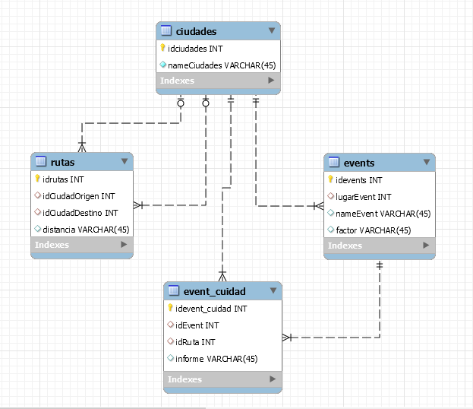
Acquisition of preliminary knowwledge and methodology

Slide 7
Implementation
Knowledge database:
The name of the cities.
The distance between the adjacent cities.
Information provided by an expert.
Information obtained from CTE.
Information obtained from INAMHI.

Slide 8
Implementation
Database:
We use MySQL to storage the data provide by the knowledge base.
Inference engine:
RETE algorithm included in Jess that uses tuples of facts and rules.
User interface:
We will use the GUI provided by java.

Slide 9
Implementation
Conclusions module:
It shows te shortest route to the user and also how obtin this conclusion.

Slide 10
References
Welcome to Common-Lisp.net!. (2017). Common-lisp.net. Retrieved 14 July 2017, from https://common-lisp.net/
Welcome to Common-Lisp.net!. (2017). Common-lisp.net. Retrieved 14 July 2017, from https://common-lisp.net/
Friedman-Hill, E. (2017). Jess® The Rule Engine for the Java™ Platform (7th ed., pp. 3-15). New Mexico: Sandia National Laboratories.
MySQL :: MySQL Connector/J 5.1 Developer Guide :: 6.1 Connecting to MySQL Using the JDBC DriverManager Interface. (2017). Dev.mysql.com. Retrieved 8 July 2017, from https://dev.mysql.com/doc/connector-j/5.1/en/connector-j-usagenotes-connect-drivermanager.html

